Slide 1
Powershell with Ansible
Ansible-lizing your Powershell Automations
Jocel Sabellano
Steve Fulmer

Slide 2

:~# whoami
Jocel Sabellano
Sr Systems Engineer, Evercore
I write automations
github.com/theitrx

Slide 3
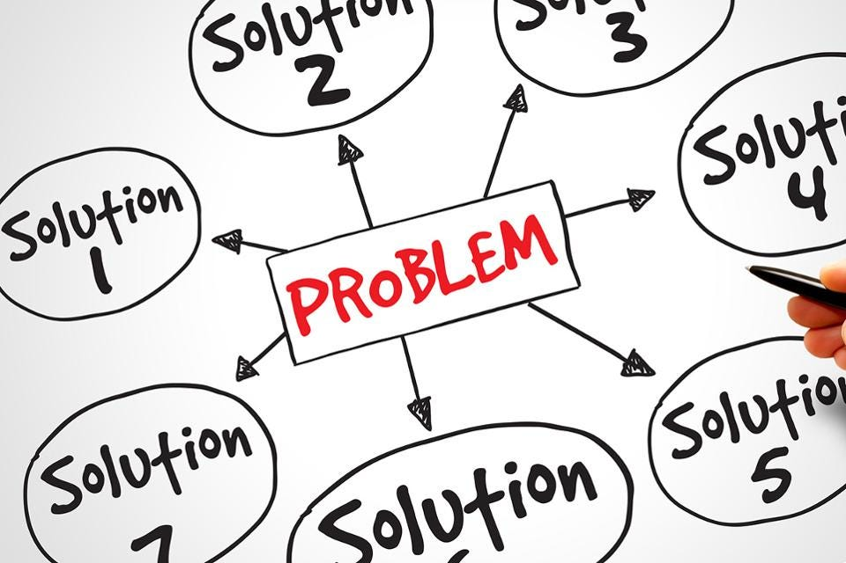
:~# Common Scenarios Real-World Challenges The Problem to Solve Governance Security Standards Enterprise Features Overcoming the Limitations Uniform Invocation Integration Channel Usability Maintainability Continuous Improvement
Notes:
In my of my engagements with clients who automation practice is not that established. common challenges on most greenfield organizations / un established automation practice / across different industries/sectors.

Slide 4
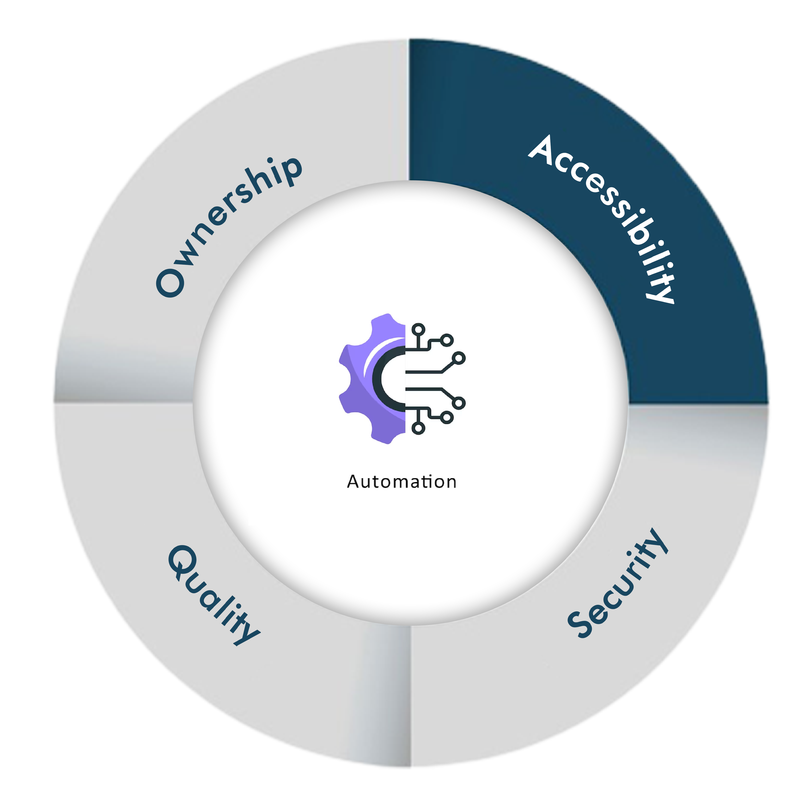
:~# Why ..Ansible-lize Powershell Automations? As a Consumer Centralization Ease of Use Integration As a Developer Maintainability Collaboration Productivity Wider ecosystem Ease of use
Notes:
We are going to talk about different perspective levels.
As an organization
As a consumer of your automations
And as the developer making the automations

Slide 5

:~# Why ..Ansible-lize Powershell Automations? Security Audit Compliance Data Collection Metrics/Telemetry Monitoring Governance Standards Operational Flows Vertical and Horizontal Expansion Continuous Improvement

Slide 6
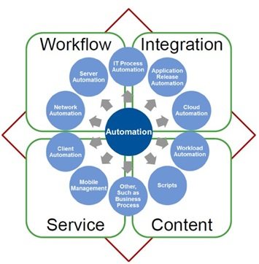
:~# Ultimate Goal The Goal An Enterprise Grade Automation Practice

Slide 7

:~# Onboarding Ansible Crawl Inventory of scripts and automation Writing pseudocode Categorization Design initial standards Setup version control Build connections Walk Migrate your scripts Implement standards Cutover invocations Setup metrics and telemetries
Notes:
Inventory→ get what automations you have, what are their uses and who uses them. Possibly Not just powershell but any automations out there.
Categorize → Those that involve human intervention or not. Or those that are daemon based. Long running scripts or quick scripts. For later to decide what automations to take care first.
Standards → Adherence to best practices. Naming, documentation, name labels on tasks.

Slide 8
:~# Onboarding Ansible Run Full-blown operations Implement Integrations Continuous improvement Optimize Fly Expand to other silos Innovate

Slide 9
:~# Authentication WinRM Enable PSRemoting Server Certificate Auto-Enrolment Bind to Winrm/Https (5986) Cert/Password/ Kerberos/Basic/NTLM/CredSSP Script – https://bit.ly/4mdeUkP
Option | Local Accounts | Active Directory Accounts | Credential Delegation | HTTP Encryption
Basic | Yes | No | No | No
Certificate | Yes | No | No | No
Kerberos | No | Yes | Yes | Yes
NTLM | Yes | Yes | No | Yes
CredSSP | Yes | Yes | Yes | Yes
Notes:
Windows Server 2019 has OpenSSH that can be enabled or as an upstream package
There is also a script that takes care of everything and generates self-signed certs.
Careful with applications that auto picks certs on the cert store and whose clients need manual setting of config.

Slide 10
:~# Authentication SSH Enable/Update SSH Server Enable service and Firewall Exceptions Key/Password/GSSAPI
Option | Local Accounts | Active Directory Accounts | Credential Delegation
Key | Yes | Yes | No
GSSAPI | No | Yes | Yes
Password | Yes | Yes | Yes
Notes:
Windows Server 2019 has OpenSSH that can be enabled or as an upstream package

Slide 11
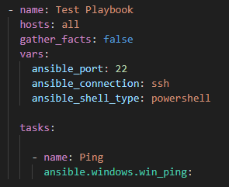
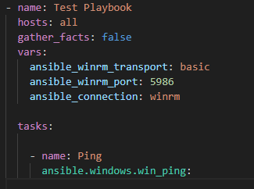
:~# Base Authentication Variables SSH WinRM

Slide 12
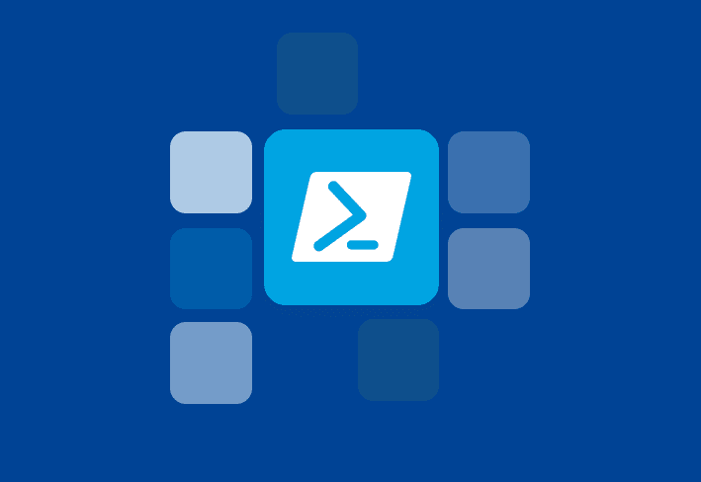
:~# Powershell-Based Modules Community.Windows Community maintained Ansible.Windows Certified Maintained by Ansible team Microsoft.AD For Active Directory Chocolatey.Chocolatey For managing windows packages

Slide 13
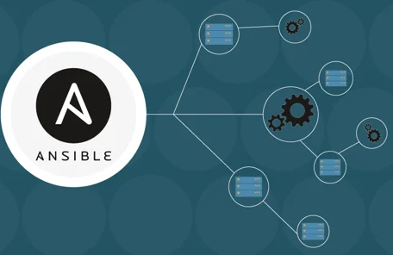
:~# Playbook Design Ansible-lization Understand the logic Write down pseudocode Build flow charts Porting your Code Direct Indirect Inline Module Adhere to Best Practices - https://github.com/ansible-community/awesome-ansible
Notes:
Write pseudocode
Direct 🡪 just a direct translation
Indirect 🡪 You write a brand new logic but still accomplishes the same output

Slide 14
:~# Demo Porting Your Code Inline Script Less preferable Not Reboot friendly Need standardized inputs and outputs Don’t do this Use Native Modules Preferred way Build your Own Module Reusable Namespace management
Notes:
Direct 🡪 just a direct translation
Indirect 🡪 You write a brand new logic but still accomplishes the same output

Slide 15
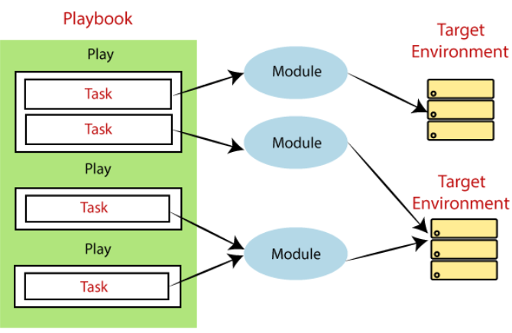
:~# Custom Collection - Modules [myamespace.windows.my_module] Best approach Distributable Consumable Modular Centralized Documentation Unit testing

Slide 16
:~# Custom Collection - Modules Best Practices Keep it simple Breakdown functions to single purpose Use common code – module_utils Consistent naming Document Clear and concise documentation of inputs and outputs Provide examples Error Handling Catch error scenarios Informative error messages
Idempotency Check current state before making changes Validate object changes Return “changed” property
Notes:
Idempotency - an operation or function that produces the same result regardless of how many times it's applied. Repeatedly executing an idempotent operation will yield the same outcome as a single execution

Slide 17
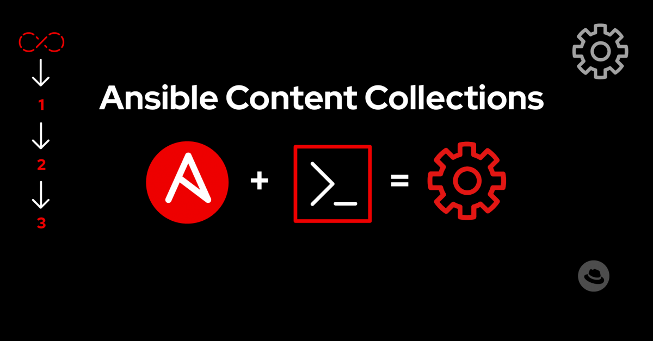
:~# Create a Collection ansible-galaxy collection init mynamespace.windows collection/ ├── docs/ ├── galaxy.yml ├── meta/ │ └── runtime.yml ├── plugins/ │ ├── modules/ │ │ └── module1.ps1 │ ├── inventory/ │ └── .../ ├── README.md ├── roles/ │ ├── role1/ │ ├── role2/ │ └── .../ ├── playbooks/ │ ├── files/ │ ├── vars/ │ ├── templates/ │ └── tasks/ └── tests/

Slide 18
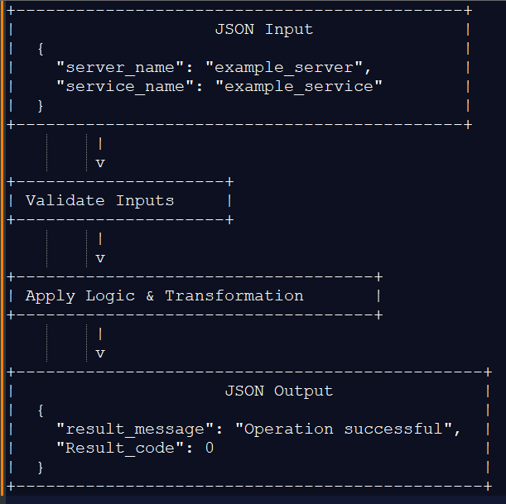
:~# Create Collection - Demo High Level Overview Build Your Code JSON in Your logic JSON out Ansible.Basic.AnsibleModule Helper functions - Interface class to Ansible Define your argument spec – input validation Define your argument spec Decide on the parameters and their types
Notes:
Argument Spec 🡪 https://docs.ansible.com/ansible/latest/dev_guide/developing_program_flow_modules.html#dependencies-between-module-options

Slide 19
:~# AAP For Enterprise Capabilities Controller API Integration Self service access Centralized Invocation RBAC controls Hub Centralized collection repo Integration with Controller Documentation Access to certified collections
EDA Reactive automation
Dynamic response to incidents

Slide 20
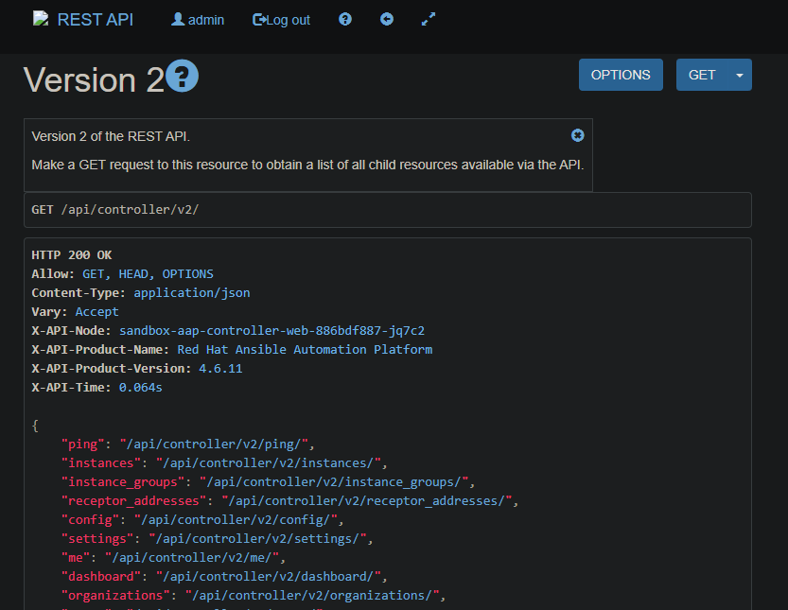
:~# API Integrations ITSM Systems Monitoring Observability Public cloud Security platforms Virtualization systems

